Slide 1
From the body to the Ideal and back Joost Kircz Soc21.nl (board member) marxismandsciences.org (editor) www.kra.nl
Knowing the world:
a combination of sensory perception and mental modelling
What are human’s most obvious senses and is that all we have?
A discussion with Ernst Mach
All terrestrial sentient and non-sentient beings interpret
the same world with the help of a great number of
diverse sensory capabilities.
So, how do we change the world?

Slide 2
We have our body, That is all
A materialistic world view simply means: there is a world before, during, and after the existence of thinking animals (aka humans). Our body is part of it.
Evolutionary, and most presumably driven by the urge for survival, we create societies.
Members of a society, in order to create a society, must be able to communicate and have common “understanding” on what is going on.
Notes:
Pagel, Mark. Wired for Culture, The Natural History of Human Cooperation. Penguin Books Ltd., 2012.

Slide 3
Nature ->cells -> body -> neurons -> thinking >
-> language

Slide 4
The dialectics of Inside out & Outside in
Nature expresses herself in living beings, who evolve
-opportunistically & pragmatically- given the available resourses
As part of nature we are a product, as well as an actor, who changes
Nature (biosphere discussion): metabolism.
GOD knows(?) how thinking and languages emerged, which put us on
distance from the erstwhile “organic” unity. We start to interpret and
change nature and our social environment consciencely / teleologically

Slide 5
Language
In order to communicate and create collaborative labour; hence society: we develop:
1) In the process of “mastering” nature, (of which we are an offspring, as well as our self, as offspring of our body) we create a natural language.
2) We reduce our vernacular to signs, sign languages (glyphs, alphabet, mathematical symbols) and simplified rules.
Simplified rules enable us to approach the reality of the world around us – as far as we understand her in our socio-historical context – and induce, Iteratively, descriptive notions and models.

Slide 6
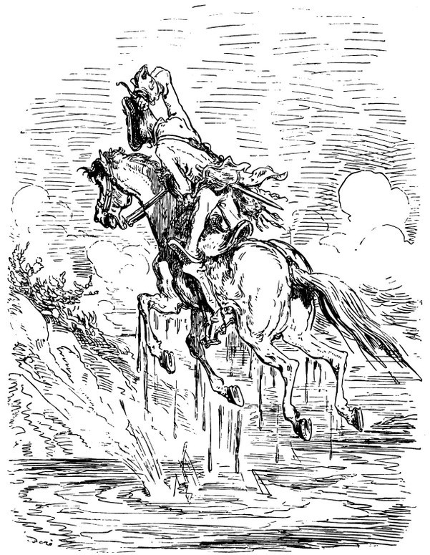
Caught in a swamp, Munchausen (1720-1797) rescued
Himself and the horse by lifting them both up by his pigtail.
First version 1786
We have the “tools” nature provided to us.
Our limps, opposable thumb,
digestion/ metabolism with our environment
Capacity of thinking; presumably a neurotic brain activity: our pigtail.
Important
Special to humans; teleology, next to interaction and adjustment with nature, the drive for mastering and change. Self-activity. Human creativity, “Picturing”/Theory building.
“Aventures du baron de Münchhausen.”
illustrées par Gustave Doré. [ca. 1862]

Slide 7
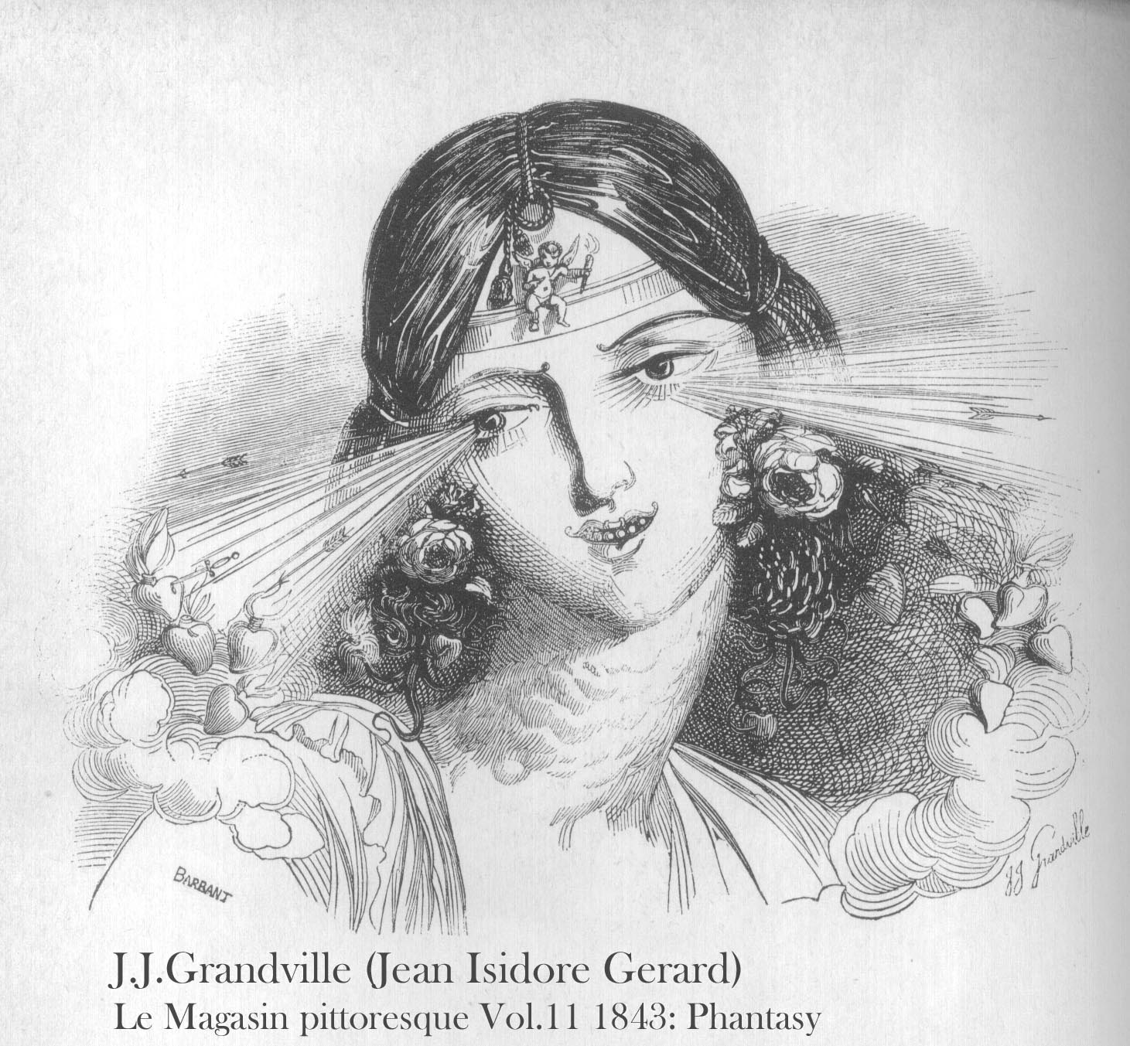
How do we interact with nature? Our –Human- Sensory Stock Aristotelian low hanging fruits
Old Five+
Vision/ sight (one way)
Touch (two ways)
Opposable Thumb
Hearing
Taste
Smell
In Hellenistic natural philosophy there were various doctrines of sight based on the idea that an opis (visual ray) was something actually emitted from the eye.
Notes:
Gary Larson, The far side

Slide 8
How do we interact with nature? Our –Human- Sensory Stock Aristotelian low hanging fruits
Old Five+
Vision/ sight (one way)
Touch (two ways)
Opposable Thumb
Hearing
Taste
Smell
Notes:
Gary Larson, The far side

Slide 9
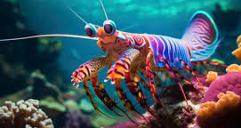
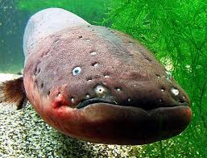
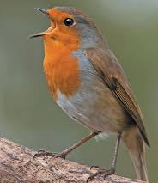
Beyond the old 5
New: Vestibular (body position, tilt),
Vision → Colour
Pain
Heat
Touch → Contact and flow
Surface vibrations
Hearing → Echo location, (clicking)
Electric Fields
Magnetic fields
Mantis shrimp
Bats
Electric eel
Migrating birds
Notes:
Choe, Jae C., ed. Encyclopedia of Animal Behavior. Second edition. Amsterdam: Elsevier/Academic Press, 2019. 6 Volumes
Yong, Ed. An Immense World: How Animal Senses Reveal the Hidden Realms around Us. London: The Bodley Head Ltd, 2022.

Slide 10
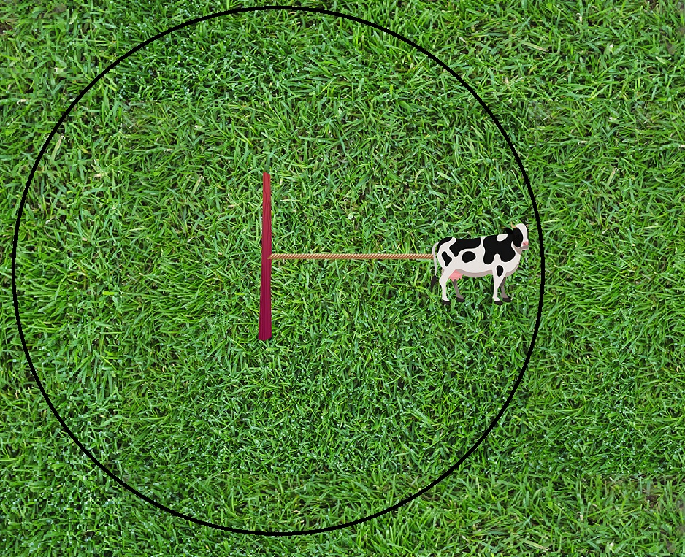
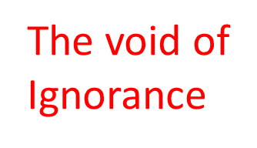
The growth of ignorance
The void of
Ignorance
Outside the
Grass meadow
The cow sees and eats
green grass and makes
white milk.
Notes:
Why are meadows just green and why no flowers or other plants: Lolium perenne Englisch ryegras, Deutsche Weidelgras, auch Ausdauernder Lolch, is outcompeting other plants.

Slide 11
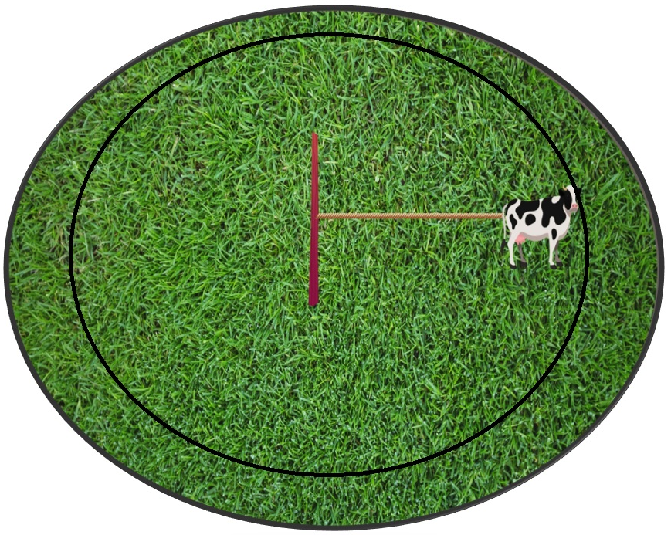
The growth of ignorance/ extending the model
Isaac Newton
The void of
Ignorance
Outside the
Grass meadow
The cow-scientist sees
and eats green grass
and makes white milk.
She assumes everything
will go with the
given paradigm
Earth
Heaven
Notes:
Why are meadows just green and why no flowers or other plants: Lolium perenne Englisch ryegras, Deutsche Weidelgras, auch Ausdauernder Lolch, is outcompeting other plants.

Slide 12
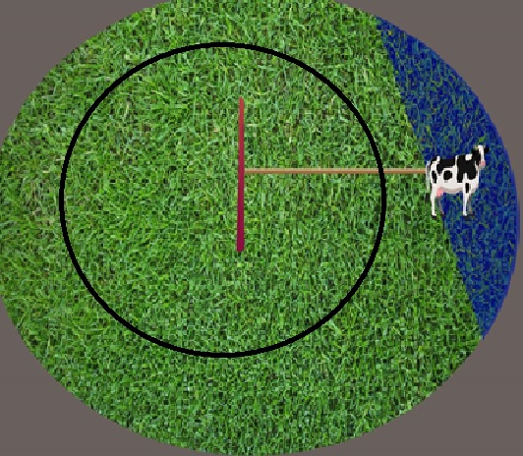
A new plot induces a change of understanding
Green Rye grass Becomes Clover
The old pigtail breaks
The old model, say Newtonian physics, (good for heaven and earth) flounders.
How to handle QM and GRT???
By the way:
Despite the matador, a cow only sees yellow and blue (dichromatic)
Humans see trichromatic.
Reptiles, insects….are tetrachromatic
Positivists get what they see, but what don’t we see?

Slide 13
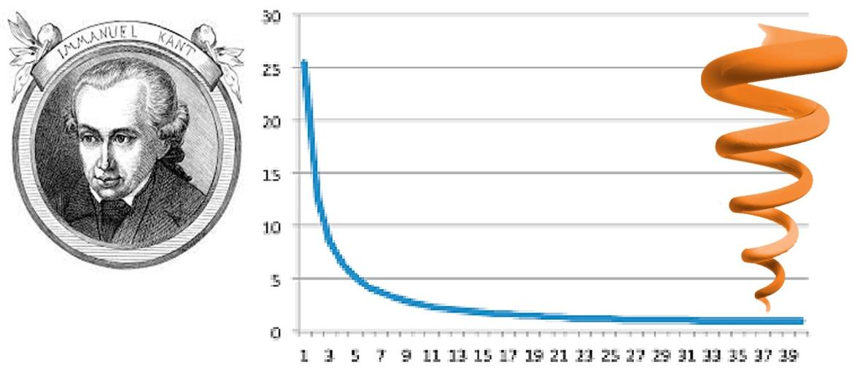
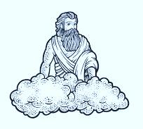
A hurdle race for reaching a finish
The growth of ignorance
1724 – 1804
Accepts our (5) senses (reine Anschauung) and stipulates, some mental fundamental notions/pigtails (space, time, causality): a prioris
Kant drills down to the ultimate Ding an Sich:
The fundamental building blocks of nature
The ultimate atoms of our model:
Made by GOD for our convenience
Notes:
Kant, Immanuel. Critique of Pure Reason. Edited by Allen W. Wood. Translated by Paul Guyer. Cambridge University Press, 1998.

Slide 14
Within the model (Newtonian physics for Kant) we try to have as little rules as possible and as many applications as possible (which is a kind of holism)

Slide 15
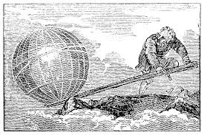
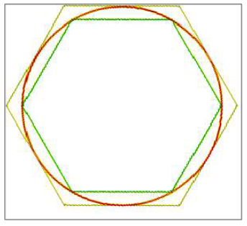
Archimedes and the approximation
Booth trapping: 1) Give me a fixed point to start with and I move the world
Motion is always relative to something
Methodological the fixed point is formal logic
How to describe continues change, e.g. a circle.
2) Method of exhaustion (~~250 BCE)
Inscribe and circumscribe two “polygons”
around the circle.
Precursor of the Calculus. Only at the end of the 19th century (CE) with a novel “understanding” of the mathematical notion of infinity, this case was closed. Footnote: Marx & Engels missed this (cf Dialectics of Nature and Marx’s Mathematical Manuscripts).

Slide 16
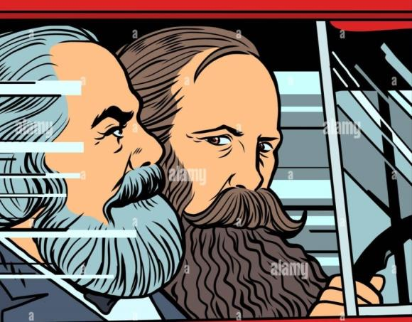
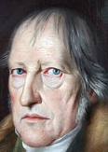
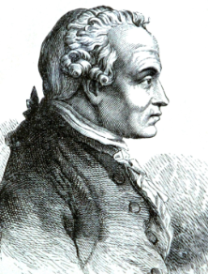
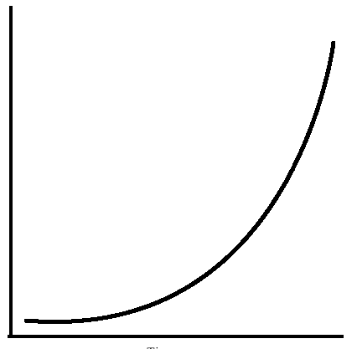
The dynamics of human thinking
Marx & Engels in the drivers seat
Putting Kant and Hegel on their heads
No finish at all!
The role of context.
In every new stage, Human understanding of Nature,is never ending, Novel entities and relations emerge.
The growth of knowledge
The growth of ignorance
Think also of Lenin’s: The electron is as
inexhaustible as the atom, nature is infinite, ……
M&E-C, CW-vol14 –p. 262
Quantity Quality Transitions
Notes:
Kircz, Joost, and Marcel van der Linden. ‘Complicating the Quantity-Quality Transition’. Critique 49, no. 3–4 (2 October 2021): 177–90. https://doi.org/10.1080/03017605.2021.2000605.

Slide 17
Are our self invented “intuitions” (again space, time, causality,…..) sufficient and can we stretch them or replace?

Slide 18
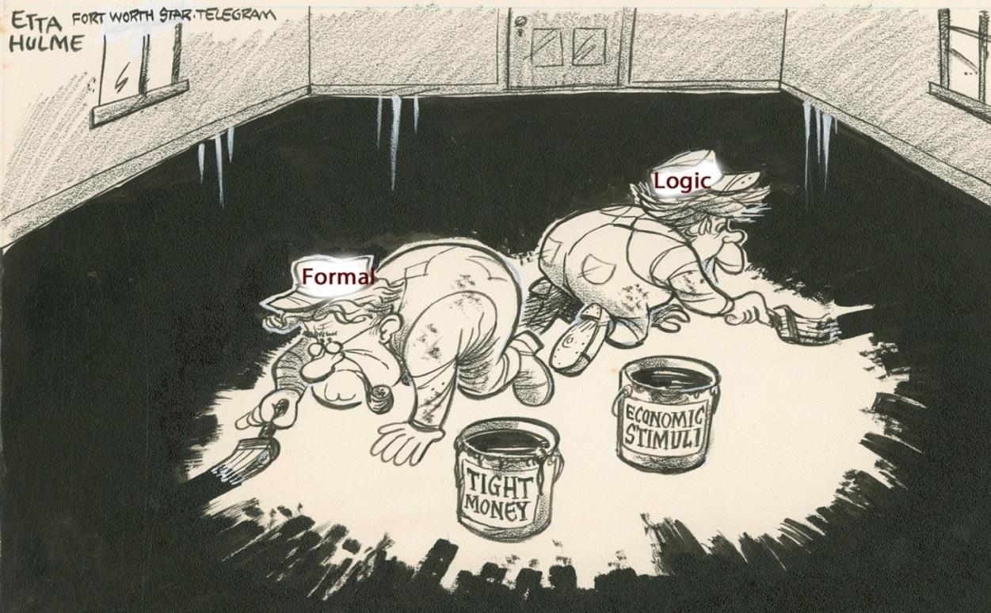
Today’s academic single minded obsession
After Etta Hulme Nov.1, 1977

Slide 19
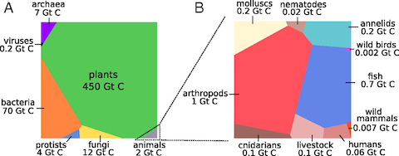
Humans are only a small part of nature in numbers and gigatons of Carbon
About 0.06 GtC of a total 550 GtC
Against: ~1 million kinds of insects we have 1 type of humans.
However: the human impact on nature (deforestation, husbandry, etc.) is enormous.
Notes:
https://www.pnas.org/doi/10.1073/pnas.1711842115

Slide 20
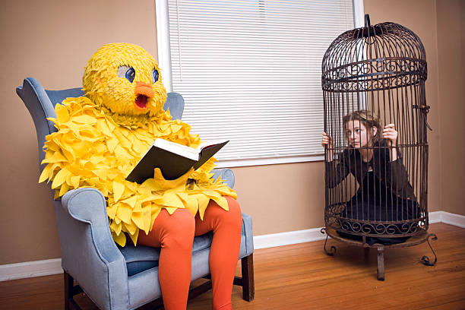
The bars of our cage: Evolutionary constraints
Kant’s Space, Time, Causality, Morals,
Social awareness, Natural Language,
Sign Language/Mathematics
Look: Our hands (senses = tools)
stick out the cage, we “see” the same world
differently At least mentally (scientifically) we
can jump out of our Box
Notes:
Godfrey-Smith, Peter. 2020, Metazoa: Animal Minds and the Birth of Consciousness. London: William Collins.
Yong, Ed. 2022, An Immense World: How Animal Senses Reveal the Hidden Realms around Us. London: The Bodley Head Ltd.

Slide 21
Ewald Ilyenkovian’s Ideal
Thinking is an expression of our ‘meaty and bony’ body. Cf, Spinoza on walking as expression of having legs.
How do we grasp/understand feelings and notions which are
difficult to express in present-day language?
Ilyenkov’s example: the Ideal Value.
We must make a distinction between:
Use-value (food, well-being, solidarity, love) and its reduction
Exchange value, typical for our commodity based society (price of kg potatoes, Insurance premium, membership fee,
prostitution per hour, housing rent). In order to exchange/ communicate we need and use a
“third party”, a generalized equivalent: Money!
Notes:
Ilyenkov, Evald V. ‘Dialectics of the Ideal’. In Dialectivs of the Ideal, Evald Ilyenkov and Creative Soviet Marxism, edited by Alex Levant and Vesa Oittinen, Vol. 60. Historical Materialism Book Series. Brill and Haymarket Books, 2014.
Joost Kircz (2023) Time = Money, A study to use Ilyenkov's notion of the Ideal in the quest for change and time in physics. Marxism & Sciences. vol.2.issue 1, p. pp. 1-52

Slide 22
Representing Kant’s Ideals in social representations
My thesis here is that the same process of understanding Value, is valid in many more situations.
Example: what do we mean with the Ideal Change. Presently we only compare change in
terms of e.g. motion (distance travelled per second, aging or duration, as that what the clock tells us). Change (as analogue for use-value) is reduced to Time, defined as the ticking of the clock: Time equals Money!

Slide 23
Getting out of our cage
At present I see two research ways to go.
Overcome the simplistic, but highly effective, tradition of formal – Aristotelian - logic (all flavours) , and the forced binary opposition of true and false statements (see above the method of exhaustion). Methodological - re-invent analogue computing vs digital computing
Investigate how other (animal) minds perceive nature using different senses.
Senses that human might have as well, as we are equal part of nature (and might have a Universal Common Ancestor) but are not developed. Due to our senses, developed in function of our biological and societal evolution.
Notes:
A discusion with Thomas Nagel; What is it to be a bat, The philosophical review, Oct 1974, Vol.83, No.4, pp 435-450.

Slide 24
Getting out of our cage
In other words:
a) We start with the holistic notion of the world. b) We experience sensory perception, but not necessarily with the same articulation as the Naked-Mole Rat, the Mackerel, the Bat, the Sperm Whale, or the Mantis Shrimp.
Because our senses developed in function of our biological and societal evolution.
{same world, different representations!}
Hence: our intuitive Ideals must have some communality, though the expression is different.
Thanks

Slide 25
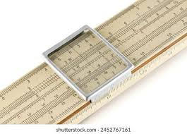
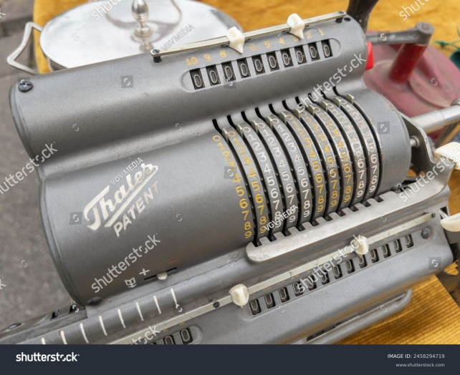
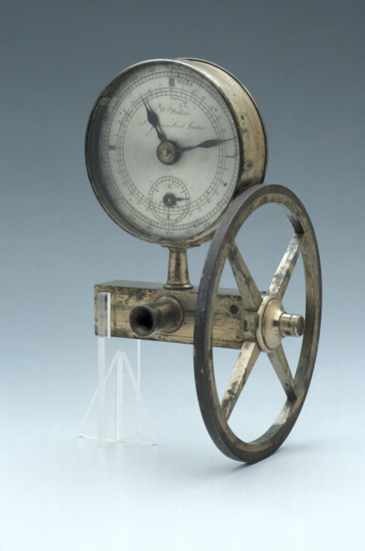
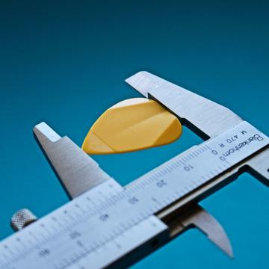
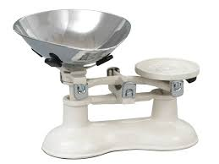
Analogue computer
Slide rule
Mechanical calculator
waywiser
caliper
balance
Notes:
https://www.quantamagazine.org/what-is-analog-computing-20240802/?mc_cid=48655a0431&mc_eid=70afb9471b
https://www.science.org/doi/10.1126/science.abp8064

