Slide 1
Bogdanov’s proletarian science, and post-revolutionary knowledge
Joost Kircz
Soc21.nl and MarxismandSciences.org
Kircz@kra.nl www.kra.nl
Historical Materialism Cluj April 2026

Slide 2

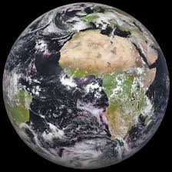
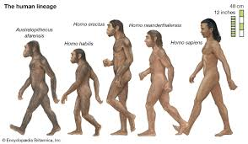
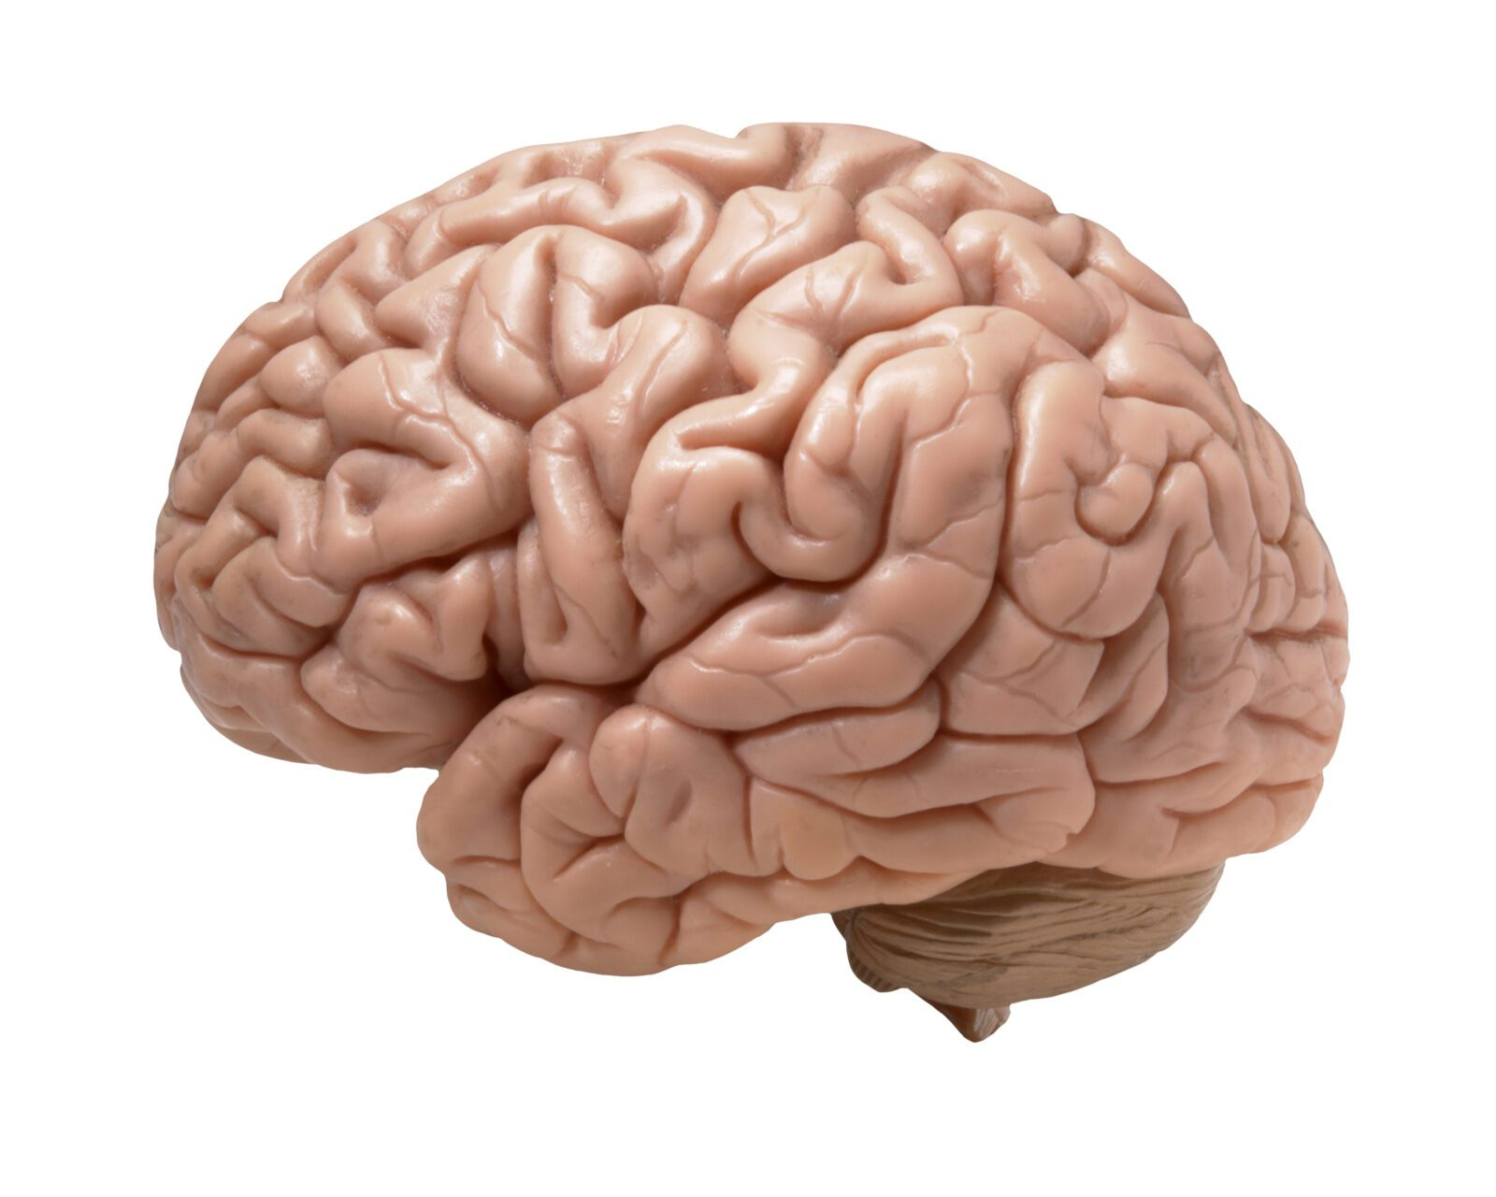
A: Prelim: One universe – one science?
The universe is considered a WHOLE, and planet earth is part of it, and humans are evolutionary spin-offs of all this.
The suggestion comes to the fore, that humans might be able to understand their existence as a result of a scientific theory encompassing everything.
The walking brain is made for understanding
?
Human Mental Model

Slide 3

Finite or infinite understanding?
Theology: “masterplan”, GOD(S) their(s) plan, The Theory of Everything (TOE), Nirvana, Magic (Psilocybin) mushrooms…….
Historical materialist approach: Knowledge is a human tool for the survival of the species and is a dynamical consequence of our bodily evolution and our social-economical history.
As our planet, and, semi-independently, our species evolve, we never will get a full representation (theory) of what is going on. {Lenin: nature is infinite}

Slide 4
Tuning knowledge and scientific theories
How do grasp reality.?
Positivists: Mach’s sensory impressions. ‘Objects are complexes of sensory elements. We experience reality by our bodily, senses.
Empirio- Monists: Bogdanov, Avenarius. The ‘laws’ of thinking are the ‘laws of nature’. Consequence: IF we understand the laws of nature THEN we understand the laws of thinking, v.v.
Marxists: Our knowledge and theories are a result of the human activity on the actual cultural (socio-historical) level.
Ilyenkov: The linguistic modelling pre-dates the pragmatic usages.

Slide 5
Ilyankovian Ideals 1 Value
We develop notions that we cannot immediately apply operationally. So-called Ideals. Value, Time, Energy, Order……
In order to compare (communicate) and calculate (trade) we need measuring rods and coordinates. Which reduce Ideal notions to operational entities.
Example 1: Value. Defined as the product of human labour. How to exchange goods? By measuring the human labour force used. And express it in Exchange value (money).
In the capitalist mode of production, trade is an ever haggling on the market. Hence, in capitalist economy, we don’t speak about value but about price expressed on the ‘coordinate’ money.

Slide 6
Ilyankovian Ideals 2 Change
In order to compare (communicate) and calculate (trade) we need measuring rods and coordinates. Which reduce notions to operational entities.
Example 2: Change. Fred Engels c.s. talk about Matter in Motion.
But what is motion? Motion we grasp by velocity, with the coordinates duration and distance. Both demand a measure.
So, if we compare a slow development with a fast one, we keep the ‘distance’ coordinate fixed (e.g., 60 km) and measure duration with a clock (1 hour). Change becomes the ticking of the clock. That ticking (a harmonic oscillator) enable comparison as a ‘universal exchange measure’: Time = money.

Slide 7
B:Bogdanov’s bourgeois science
In our present culture, everything is reduced to exchangeable entities, in competition. The wholeness of ‘nature’ is reduced, to commodities (measurable entities exchangeable with money).
Bourgeois Science is splintered in individual fields, models, and theories.
Bogdanov adheres to Histomat. It are the socio-economical developments that lead to the present – bourgeois – situation.
Consequently, a socialist revolution will give birth to one (1) novel science.
In which commodification is eradicated and individual workers / artist/ scientists will work creatively in harmony and solidarity.
So, what will become this unifier in history?

Slide 8
Bogdanov’s proletarian science
As the proletariat is the ultimate suppressed class, it will be the proletariat that will topple capitalism and introduce a novel societal phase and, hence, a novel phase in comprehensive scientific thinking.
This thinking is not based on exchangeable objects (commodities), but on relations between the complexes of sensory elements of humans.
As from then, we talk about organization and the novel unified science of organization: Tektology.
We reformulate objects and their interactions, into a system of operations that universally relate what we call presently: objects.

Slide 9
Bogdanov’s theses on Proletarian Science
See: marxismandsciences.org issue 8 p.256- 260
Call for a unified science, as also the Logical Positivists do
#5
What all of this means is that bourgeois science, whilst it accumulated in all its branches an enormous wealth of knowledge and of methods for exploiting that knowledge, has been unable to assemble this material into a planned, organized and integrated whole. Each specialism has created a language of its own that has become incomprehensible not only to the broad masses but even to scientists of another specialism.

Slide 10
Bogdanov’s theses on Proletarian Science
#6
The development of machine production, which brought about a unity of technical methods, stimulated a trend in science for the unification of methods and an overcoming of the harmful aspects of specialization.
#12
A reinterpretation of the content and a transformation of the external form of science will mean that “socialism” will become its foundation, which is to say that science will become adapted to the tasks of the struggle for, and construction of, socialism.

Slide 11
From now to post revolutionary science! 1
To introduce a non-capitalist all-encompassing model we do need a socialist revolution. This needs preparatory actions and organization.
Here, Bogdanov’s depart form the Marxist tradition.
Fundamentally:
Bogdanov, adheres to equilibrium and sees progress as ‘dynamical equilibrium’ (think also about Bukharin’s economical thinking). The fundamental wholeness comprises of dynamical motion within an essentially equilibrium situation. No breaks, kinks, or jumps.
Marxist dialectics takes oppositions, negations, and transcending as fundamental ingredients. Social change introduces novel notions, rules, and understanding.

Slide 12
From now to post revolutionary science! 2
2) Practically
How do we change society from capitalist to post capitalist?
- AgitProp (how to reach the illiterate majority of the population?)
- Education (Proletkult initiative)
- Political organization (Party and trade union building)

Slide 13
Caveats towards after a socialist revolution
Underestimation of the transition time between capitalism and socialism. Despite major educational initiatives.
Danger of rephrasing ‘experimental’ results and novel theories on the procrustean bed of State Dialectical Materialism (Diamat) “laws”.
Or in the Bogdanov case: declaring that everything is relations in an organizational context. {Bogdanov on relativity theory, and Carlo Rovelli on his relational quantum mechanics}
Mixing of the applied sciences and knowledge, with model and theory development.
Dreams of a final equilibrium state without jumps, breaks, or catastrophes.

Slide 14

Questions
I. Bogdanov’s equilibrium thinking is ad odds with dialectics, in particular transcendence and quantity quality transitions.
II. Are relations an ontic category ????

Slide 15
Thank you
More on
www.kra.nl Publications Papers in Politics, Science and Philosophy
'Walking on the beach of Helgoland with Alexander, Carlo, and Werner'; Arguing about Marxism versus Positivism’ (pdf)
Bogdanov and the discussion on proletarian science (pdf)

