Slide 1
Historical materialism & Science Or The finiteness of our scientific models/theories
Joost Kircz
www.kra.nl
Berlin MPIWG, April 17, 2023

Slide 2
Welcome, and many thanks to Alex Blum and Sascha Freyberg for the invitation to speak here.
I’m not a theoretical physicist, nor a mathematician, nor a philosopher.
If the following is Marxism, maybe Karl Marx would again say: Then I’m not a Marxist.
Notes:
In letter of F. Engels to Conrad Schmidt in Berlin, 5 August 1890. “As Marx said of the French Marxists in the late seventies:
'Tout ce que je sais, c'est que je ne suis pas Marxist “, MECW vol. 49.

Slide 3
It is a well known American instruction to speakers to start with a joke.
First I’ve to apologize for my International English.
So, we start with two Jews meeting each other in NY in 1945
J1: Hello, Vat are you doing here
J2: Vell I’m polishing up my English
J1: AHa, I zink you can better English up your Polish

Slide 4
Sabine Hossenfelder
Notes:
https://www.youtube.com/watch?v=Hmy-N4AFNDM&list=PLBQq3Fsq6GmrCxGbRXRpOuSdyJ7wzU4wc&index=63

Slide 5
What is my quest
Within Historical Materialism we argue that all human factual knowledge and understanding is the consequence of an historical process, grounded in biological evolution and human societal productive capabilities
Hence, all knowledge and human models and theories are contingent/ contextual.
In the ever increase of our knowledge we are confronted with an ever growing ignorance.
For that reason all closed thinking including formal logic are approximations only.

Slide 6
The universe is a whole Hence, there must be a structure.
A Draft outline
What can we find out about this structure?

Slide 7
In this talk I will use various approach routes

Slide 8
The essential aspect of knowledge is the ever increase of ignorance*
1st Aspect
I refer to: (neuro)biologist
Stuart Firestein’ book.
Ignorance how it drives science
And astrophysicist Neil de Grasse
Tyson and his fight to people who
Equate ignorance with God.
*) sounds a bit like entropy.
Notes:
Firestein, Stuart. Ignorance: How It Drives Science. New York: Oxford University Press, 2012.
De Grasse Tyson, Neil, The perimeter of ignorance, Natural History Magazine, November, 2005.

Slide 9
After a great many years Prof. Frenkel’s understanding of Entropy drops negative!
Notes:
https://www.youtube.com/watch?v=EIeUoQZm5yo at 23 min

Slide 10
Arthur Eddington Goes out fishing
(1) No sea-creature is less than two inches long.
(2) All sea-creatures have gills.
These are both true of his catch, and he assumes tentatively that they will remain true however often he repeats it.
In applying this analogy, the catch stands for the body of knowledge
which constitutes physical sciences, and the net for the
sensory and intellectual equipment which we use in obtaining it.
Notes:
Arthur Eddington, The philosophy of physical science; Tarner Lectures 1938, Cambridge UP, 1939, p. 16.

Slide 11
It is not about the net but the sea
Eddington: the catch stands for the body of knowledge
However: The real quest is the sea. That what we don’t know, might dream of, or suggest.
Human advance is about entering the unknown and extending our ignorance.

Slide 12
Ever since Albert
We give a geometrical explanation

Slide 13
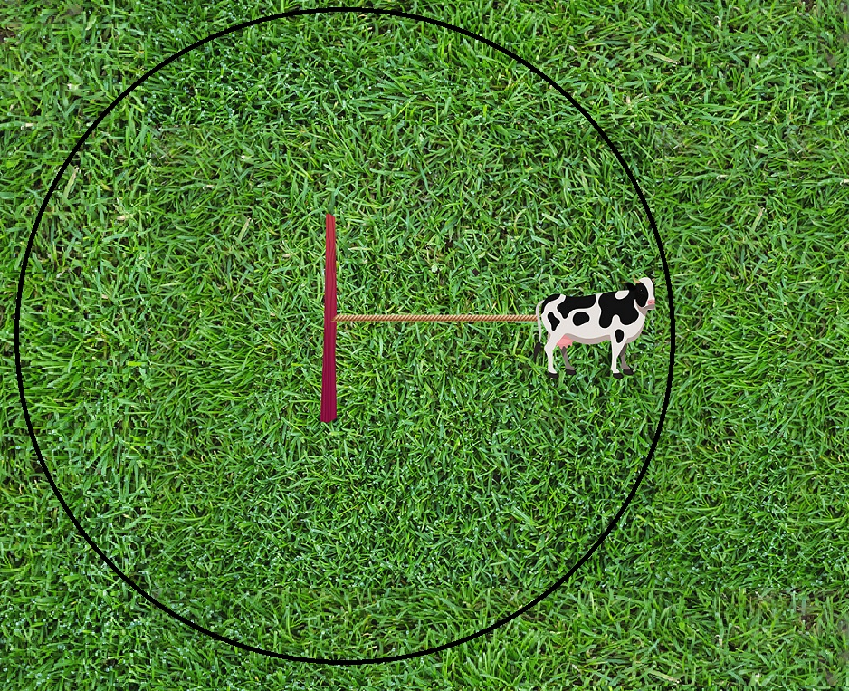
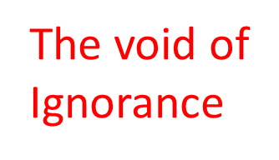
The growth of ignorance
The void of
Ignorance
Outside the
Grass meadow
Notes:
Why are meadows just green and why no flowers or other plants: Lolium perenne Englisch ryegras, Deutsche Weidelgras, auch Ausdauernder Lolch, is outcompeting other plants.

Slide 14
Happily the US-Dept. of Defense (DoD) is alert on unknown UFOs!
PHYSICAL CONSTRAINTS ON UNIDENTIFIED AERIAL PHENOMENA Abraham (Avi) Loeb (1) and Sean M. Kirkpatrick (2) 1) Head of the Galileo Project, Astronomy Department,
Harvard University 60 Garden Street, Cambridge, MA 02138, USA 2) Director of All-domain Anomaly Resolution Office 1010 Defense Pentagon Washington DC 20301, USA
OFFICE OF THE DIRECTOR OF NATIONAL INTELLIGENCE 2022 Annual Report on Unidentified Aerial Phenomena
Unidentified Aerial Phenomena (UAP) reporting is increasing, enabling a greater awareness of the airspace and increased opportunity to resolve UAP events. In addition to the 144 UAP reports covered during the 17 years of UAP reporting included in the Office of the Director of National Intelligence (ODNI) preliminary assessment, there have been 247 new reports and another 119 that were either since discovered or reported after the preliminary assessment’s time period. This totals 510 UAP reports as of 30 August 2022
Notes:
https://lweb.cfa.harvard.edu/~loeb/LK1.pdf
https://www.dni.gov/files/ODNI/documents/assessments/Unclassified-2022-Annual-Report-UAP.pdf

Slide 15
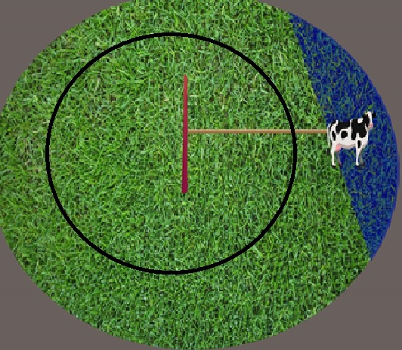
A new plot induces a change of understanding
Rye grass
Becomes
Clover

Slide 16
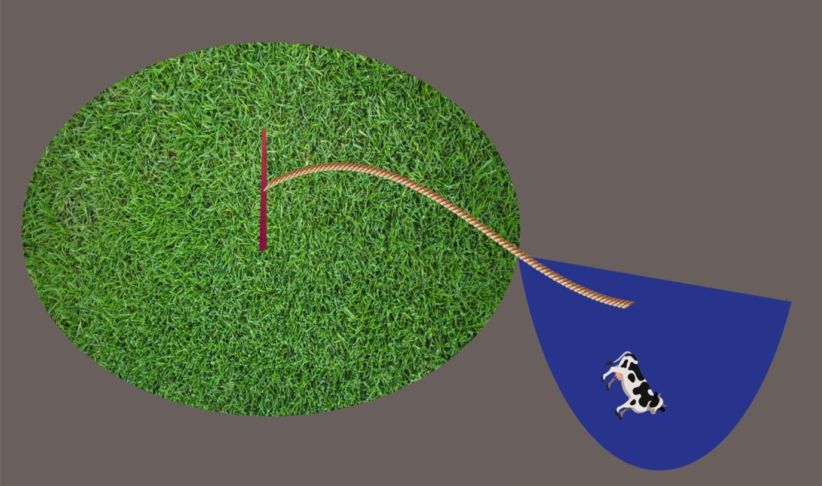
Old knowns and Old unknowns versus
Novel knowns and Novel unknowns
Scientific revolution

Slide 17
2nd Aspect
What can humans experience /Measure
How do they express them in language in order to communicate
What about the human senses?

Slide 18
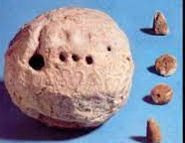
The role of language
-We experience bodily effects
-We couple them with sounds
-We communicate this sound to a fellow Humanoid
-We establish a (local) language
After a very long period
In labour and communication the language get structured
We try to communicate “globally”
The emergence of standardization
The emergence of signs (e.g. for long distance trade; tokens)
The emergence of writing (communication freed from place and time)
The quick brown fox jumps over the lazy dog
After a bit shorter period
The establishing of common models (including myths)
Quite recently
Scientific theories, formal sign languages,
Formal rift between Knowledge& Understanding
Notes:
Schmandt-Besserat, Denise. How Writing Came About. Austin, Texas: University of Texas Press, 1992.
Peter Damerow, e.g., 1999, The origins of writing as a problem of historical epistemology https://www.mpiwg-berlin.mpg.de/sites/default/files/Preprints/P114.pdf
Olson, David R., and Nancy Torrance, eds. The Cambridge Handbook of Literacy. Cambridge, N.Y: Cambridge University Press, 2009.

Slide 19
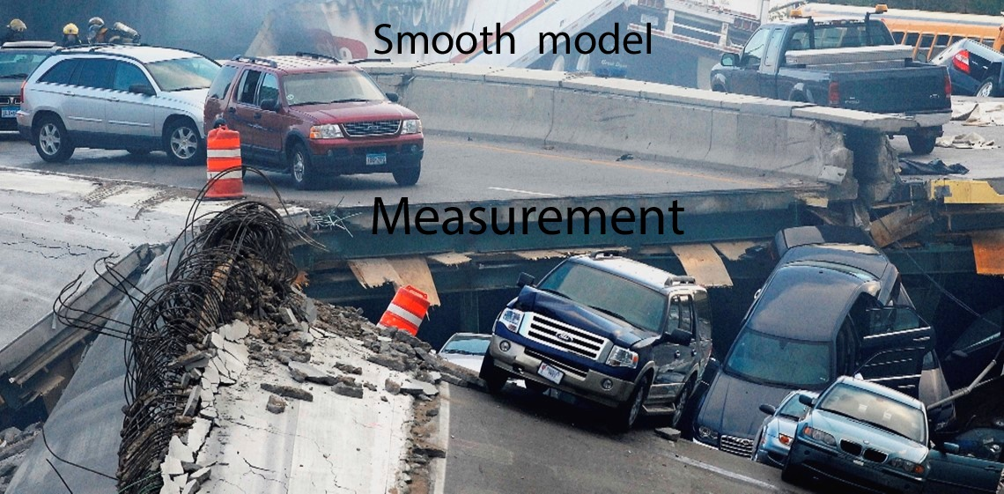
Newtonian worldview
Real traffic and Real collapse of a bridge
A real measurement of real objects before and after the disaster
Messy results

Slide 20
In QM, the theory lives in Hilbert space
The collapse of the bridge IS the measurement
We measure the probable outcome
|<Ψ | Φ>|²

Slide 21
Our –Human- Sensory Stock
Old Five+
Vision
Hearing
Touch
Opposable Thumb
Taste
Smell
New: Vestibular (body position, tilt)
Notes:
Gary Larson, The far side

Slide 22
Our Sensory Stock plus
To take into account e.g.
Magnetoception
Echolocation
Electroreception
Hygroreception
Infrared sensing
Others
Sense for time
Intuition
clairvoyance????
Young Ernst Mach

Slide 23
“looking” in- or outside?
A problem with the positivist approach to the senses is that here ‘the self’ is seen as an object outside the brain, to be inspected. Our tools are then touch, vision, etc.
“What mirror will show him the
reverse side of his eye, and in what
device will his own act of vision
be recorded?” (Castoriadis)
But we experience the self most of the time, not while shaving but if we experience pain, emotions and feel the tension of our skin (our own shrink foil) from within.
Presently, we don’t have a measure for this inside-out measurement as we have for outside-in experience such as the colour of your hair or your shoe size.
René François Ghislain Magritte 1931
Notes:
Castoriadis, Cornelius. Crossroads in the Labyrinth. Brighton: Harvester, 1984. Epilegomena to a Theory of the Soul, p32

Slide 24
We define objects
Definition
As stable entities
Invariance
Intrinsic measure
Manipulating
We know them by measuring them in some coordinate system
Subsequently we introduce units of measure

Slide 25
Are we alone in the universe and worse are we the only possible interpreters?
The anthropomorphic quest of the uniqueness of our –human- life form in our real universe.
Notes:
Or we alone in the universe and worse are we only possible interpreters.
Stanley Kubrik, 1968, 2001, a space odyssey

Slide 26
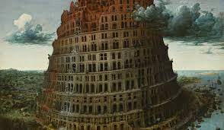
3rd Aspect
Ever since Babylon
The search for a universal language (Neurath – Carnap - Esperanto)
Or get rid of the
(contextual) details and posit a sign language

Slide 27
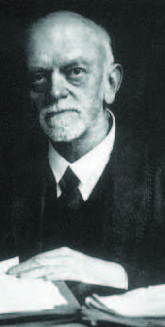
David Hilbert Radio: 1930
In der Tat: Wir beherrschen nicht eher eine naturwissenschaftliche Theorie, als bis wir ihren mathematischen Kern herausgeschält und völlig enthüllt haben. Ohne Mathematik ist die heutige Astronomie und Physik unmöglich; diese Wissenschaften lösen sich in ihren theoretischen Teilen geradezu in Mathematik auf.
." Indeed: we no sooner master a scientific theory than we have peeled out and completely revealed its mathematical core. Without mathematics, today's astronomy and physics are impossible; these sciences virtually dissolve into mathematics in their theoretical parts.
Mathematical models as shrink foil!
Notes:
https://www.maa.org/book/export/html/326610

Slide 28
4th Aspect
All communication is socially contextual

Slide 29
Historical Materialism
There is a real world of which humans are evolutionary offspring
Our bodily and mental understandings are contingent on our productive forces
Thinking is a bodily expression (following Spinoza’s example about walking and legs)

Slide 30
Diamat exaggerations
According to Dialectical Materialism (J.W. Stalin 1953) first we declare the overarching so-called dialectical and then stipulates that histomat is an extension of dialectics.
In opposition to this religious approach,
Histomat posits that our capabilities (technical and mental) are historical processes. First the living/production and subsequently our models&theories (cf. Brecht: Fressen -> Moral).
Dialectics is a Human model
Notes:
Stalin 1938: https://www.marxists.org/reference/archive/stalin/works/1938/09.htm
Klaus <-> Wetter, Horoetz etc.

Slide 31
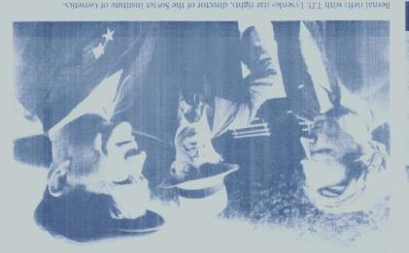
Simplistic relations
The famous John D. Bernal started with his important work The social function of science, slipped in pure catechisms in his highly popular Science in History (and praised Stalin as a genius in all fields of knowledge).
John Desmond Bernal (FRS)
&
Trofim Denisovich Lysenko
(Stalin and LeninPrize)
In the same vein of history writing we have Alfred Sohn-Rethel, Intellectual and Manual Labour.
Notes:
Bernal, John Desmond. The Social Function of Science. George Routledge & sons Ltd., 1930.
Bernal, John Desmond. Science in History. Harmondsworth: Penguin Books Ltd., 1969.
https://jbshaldane.org/bernal/bernal-1953-stalin-as-scientist.html
Sohn-Rethel, Alfred. Intellectual and Manual Labour. The Macmillan Press, 1978.

Slide 32
The issue of productivism where knowledge starts
We have to start with the human body as part of nature.
As Georg Lukács stipulates, Human Labour is the only ontological force we have.
It is human activity and production that induces and shapes our knowledge, models, and theory
This is immediately the source of the tension between ‘reality’ (what we experience) and theories and belief systems.
Notes:
Lukács, Georg. Prolegomena Zur Ontologie Des Gesellschaftlichen Seins. Edited by Frank Benseler. Vol. 13. Georg Lukács Werke. Luchterhand, 1984.

Slide 33
How deterministic is transcending from one historical phase to a next one?
When Marx & Engels analysed 19c society and the consecutive forms of oppression and formulated their class analysis, they stipulate that with the working class, within the capitalist mode of production, we reach a bottom line.
So, to overthrow their oppression the working class have to overthrow the system.
“Have to” not “will”
as Rosa Luxemburg famously stipulated.
It is not a law!

Slide 34
A good scientific theory suggests predictions based on regularities (aka laws)
Historical studies can ‘explain’ not prove why we arrived where we are and can only ‘suggest’ analogous advancing developments for the future.
Reminder as well: The Hellenistic culture was very advanced and
after its demise it took till ‘the scientific revolution’ to pick up again.
Notes:
Russo, Lucio. The Forgotten Revolution. How Science Was Born in 300BC and Why It Had to Be Reborn. Springer, 2004.

Slide 35
5th aspect Representations and laws
Examples
Fish and Quantum mechanics
Fish in shrink foil,
Fish as such
Fish in analytical determination

Slide 36
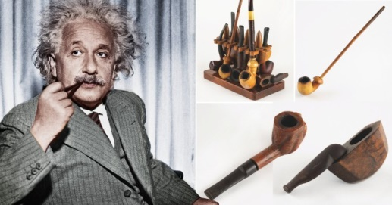
Eddington’s Fish as found
For non scientific reasons the fish is smoked

Slide 37
Fish described in shrink foil
A description/determination from the outside

Slide 38
Removing its own shrink foil aka skin

Slide 39
Analysing the digestible parts Introducing boundary conditions

Slide 40
The bare bone mathematical structure
Does the final determinations induces the fish?

Slide 41
Contrary to Mackerel, QM lives in Hilbert Space
But QM claims to envelope in mathematical space, the “thing” living in physical space
What does the theory suggest us for physical space?
The finite knowability: Niels Bohr’s complementarity?
What does a model mean if taken for an approximate truth?
Fundamentally probabilistic
wave function collapses (most theoreticians)
consistent / decoherent histories (Robert B. Griffiths)
- Introduction of new force/potential (David Bohm, Peter Holland) in phase space
Super determinism, cellular automata (Gerard ‘t Hooft)
Relational (Shelly Goldstein, Carlo Rovelli)
P-adic structure /non Euclidian metric (Tim Palmer)
Etc.
Notes:
Tim Palmer: Does Bohmian Theory Have to Be Nonlocal? New Directions for Analysing the Bell Theorem.
Https://www.youtube.com/watch?v=uDUmnWzQSBs Griffiths, Robert B. Consistent Quantum Theory, Cambridge: Cambridge Univ. Press, 2003.
Bohm, David. Causality and Chance in Modern Physics. New ed., Reprint. London: Routledge, 1997.
Holland, Peter R. The Quantum Theory of Motion, An Account of the de Broglie-Bohm Causal Interpretation of Quantum Mechanics. Cambridge University Press, 1993.
’t Hooft, Gerard. Cellular Automaton Interpretation of Quantum Mechanics. Place of publication not identified: Springer international, 2018.

Slide 42
6th aspect
A never ending story
I expect that all attempts to do without fundamental laws of nature, if successful at all, simply result in the introduction of metalaws that describe how what we know now came about. Weinberg’s Dreams p.233
OR
A final knowing?
My own guess is that there is a final theory,
and we are capable of discovering it. Idem. p. 235

Slide 43
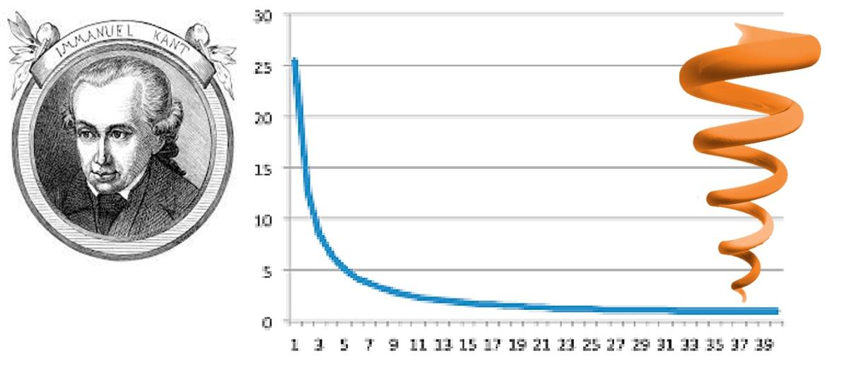
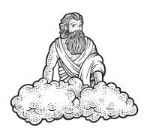
We drill down to the ultimate Ding an Sich:
The fundamental building blocks of nature
The ultimate atoms of our model:
Made by GOD for our convenience
Note: Although Immanuel believes in GOD, he has no beard.
Though Fred is an atheist and has a beard. No dialectics involved!
Notes:
Kant, Immanuel. Critique of Pure Reason. Edited by Allen W. Wood. Translated by Paul Guyer. Cambridge University Press, 1998.

Slide 44
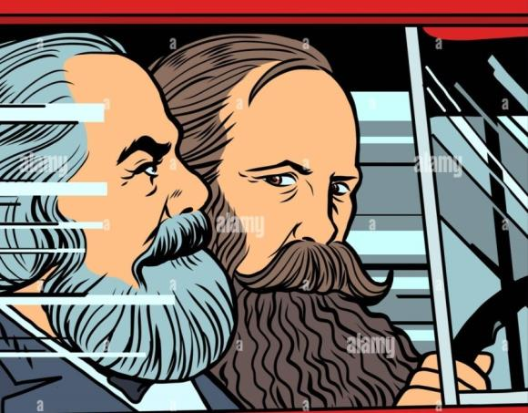
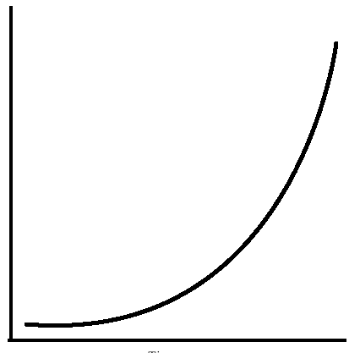
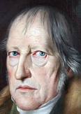
The role of context.
In every new stage in Human understanding of Nature
Novel entities and
relations emerge.
Quantity Quality transitions
Inverting
Notes:
Kircz, Joost, and Marcel van der Linden. ‘Complicating the Quantity-Quality Transition’. Critique 49, no. 3–4 (2 October 2021): 177–90. https://doi.org/10.1080/03017605.2021.2000605.

Slide 45
Against Structuralism
The structuralists agree that semantic notions are contingent but dream of fixed universal underlying stable structures.
Their love for math, in particular set theory, started already with Claude Lévi‐Strauss in 1949.
And culminated in Althusser's denial of history and Lacan’s toying with formulae.
{does this ring a bell in Relational QM????}
Notes:
LÉVI -STRAUSS, Claude. The Elementary Structures of Kinship (Les Structures Élémentaires de La Parenté) 1949. Translated by James Harlee Bell, John Richard Sturmer, and Rodney Needham. Revised Edition Translated from the French. Beacon Press Boston, 1969.
Dosse, François. History of Structuralism: The Rising Sign, 1945-1966. Translated by Deborah Glassman. Vol. 1 Minneapolis, Minn: University of Minnesota Press, 1997.
Dosse, François. History of Structuralism: The Sign Sets,1967-Present. Translated by Deborah Glassman. Vol.2. Minneapolis, Minn: University of Minnesota Press, 1997.
Wilcken, Patrick. Claude Levi-Strauss: The Poet in the Laboratory. London: Bloomsbury, 2011.

Slide 46
Scientification (or scientology)?
If we dream of a final theory, structure, law, representation, etc., implicitly, we strife for a final (Kantian) destination.
This does NOT mean that we cannot strife for a limited inter-human transparent language (pasigraphy) in some contexts, cf. Neurath, Carnap.
As argued above: We hardly understand our body, we don’t understand our mind, we cannot organize our human society: why should we claim universals an sich ? Beyond contingent environments.

Slide 47
7th aspect
What is a notion
What is an Ideal

Slide 48
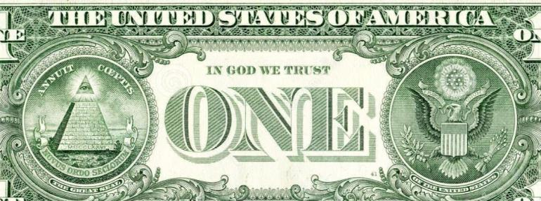
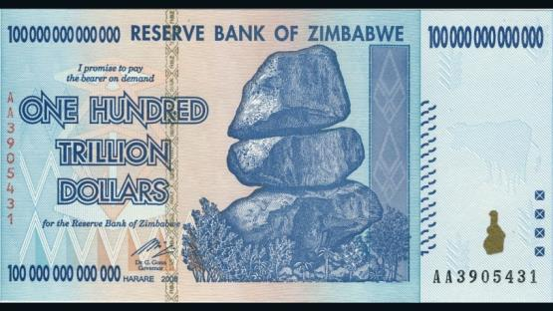
Ewald Ilyenkov and the Ideal
Ideals are ‘real’ notions, however they express themselves in opposing representations in different situations. Standard example:
Value: Exchange Value versus Use value
In day-to-day operations we simplify deal with a –linear- social- (but religious) measure: Money
He (=God) favours our undertaking.
New Order of the Ages
Notes:
Ilyenkov, E. V. The Dialectics of the Abstract and the Concrete in Marx’s Capital. Translated by Sergei Syrovatkin. Delhi: Aakar Books, 2008.
Ilyenkov, E. V, and H. Campbell Creighton. Dialectical Logic: Essays on Its History and Theory. Delhi: Aakar Books, 2008.
Ilyenkov, Evald V. ‘Dialectics of the Ideal’. In Dialectivs of the Ideal, Evald Ilyenkov and Creative Soviet Marxism, edited by Alex Levant and Vesa Oittinen, Vol. 60. Historical Materialism Book Series. Brill and Haymarket Books, 2014.

Slide 49
Ideals in physics
Entropy: $∆S$=K_{B}Ln(W) versus dS=dq/T
In a binary world view we can represent Entropy as a “bit” of information. Zero and One (nothing and something?)
Change.
How to experience (think of) Change if we cannot compare the situation a with b, without a measure or an absolute memory? (aka block universe)
The tentative solution is ongoing Clock Time as measure. Rapid xtalisation is fast but means a lot of Change. Idem for only 1 year war.
This relates to the notion of proper time (where the clock is (part of) the changing system)

Slide 50
Time = money An agent of exchange
This approach advances the discussion on Value and its representations in use resp. exchange value.
In order to communicate, that is to say exchange and compare e.g. in trade, we need a (contingent) measure.
In Economy and now also in our society the ‘universal equivalent’ is money
In the case of Change the universal measure is clock time.
Do I hear: Wait a moment!
I don’t buy that argument
Notes:
Joost Kircz: Time=Money: The Notion of the Ideal Applied to Physics, Marxism and Sciences, Vol2 #1 spring 2023
https://marxismandsciences.org/wp-content/uploads/2022/09/kircz_ms_230102101.pdf

Slide 51
Another logic/math
Obviously the best –present- way to automate is by formal ‘logical’ rules. Formal logic and its modal offsprings allow classes of shrink foil.
Calculus incl. the limit notion, Method of exhaustion, Finite element method, So-called AI.
Every child recognizes a dog, but we need super computers to recognize dogness using 1000x more energy. (Tim Palmer)
Emerging properties, novel levels of understanding, are difficult to mold into ‘old wine sacks’.
Can new notions equally be made operational as old ones? Or is Niels Bohr right that the buck stops at complementarity?
In my view it is way to early to claim so, more mathematical ‘engineering’ like string theory or AI does not bring us further to understanding.
Hence, the quest for novel mathematical ideals.
Notes:
Tim Palmer - Creativity & Consciousness: A Consequence of the Brain’s... Energy Efficiency?
https://www.youtube.com/watch?v=wotOTuJI5CE at 34 minutes

Slide 52
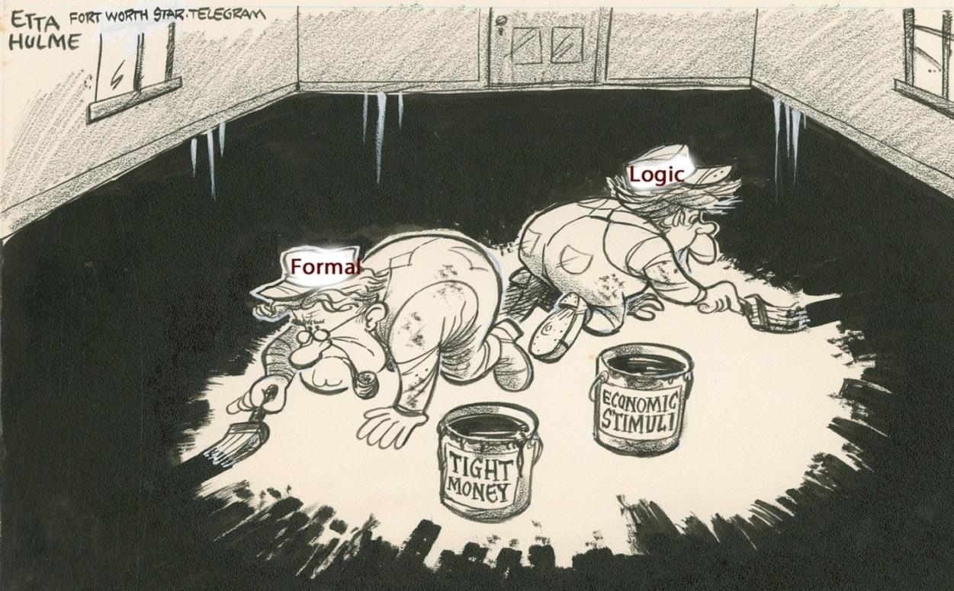
Today’s academic obsession
After Etta Hulme Nov.1, 1977

Slide 53
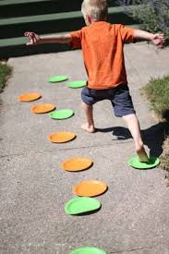
A lesson from Biology
Evolutionary adaptation
The best next step is that step that allows the largest number of choices in the subsequent step(s).
So, a kind of non-linear hop, skip and jump progression.

Slide 54
Thank you for your time and hopefully understanding
Physics isn’t math.
It ‘s choosing the right math.
P.234
I would like to say:
The beauty is in finding
other types of
Mathematics
Notes:
Hossenfelder, Sabine. Lost in Math: How Beauty Leads Physics Astray. First edition. New York: Basic Books, 2018.

